Slide 1
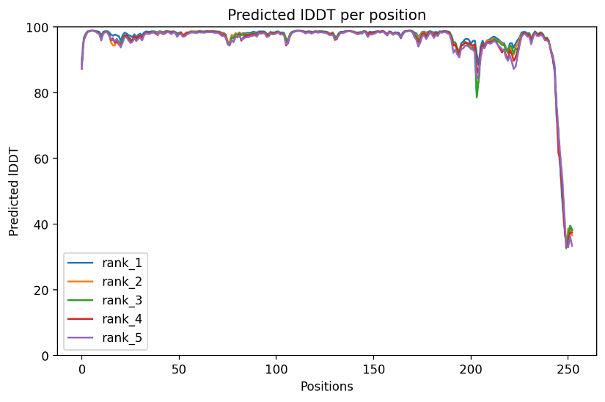
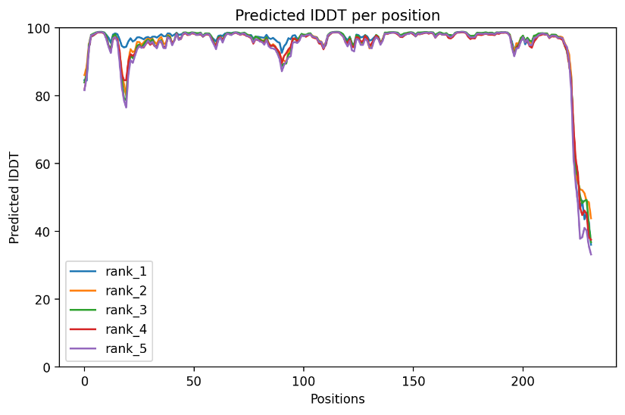
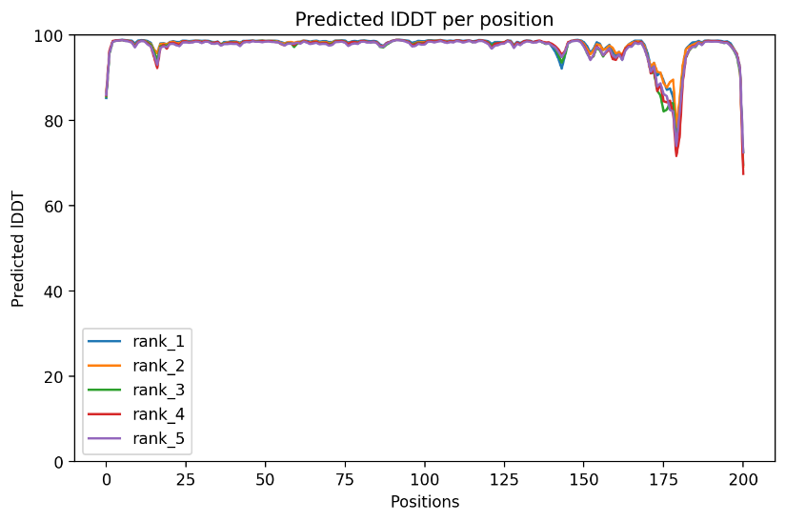
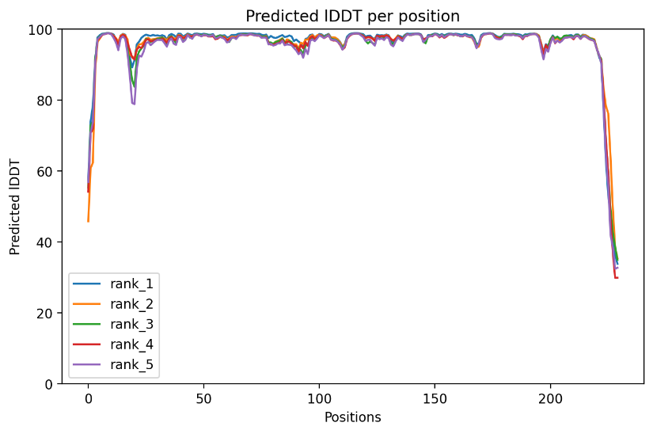
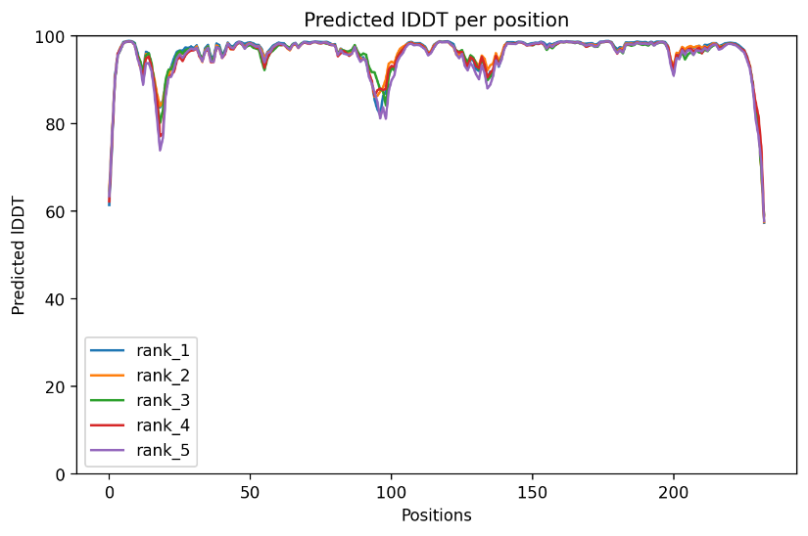
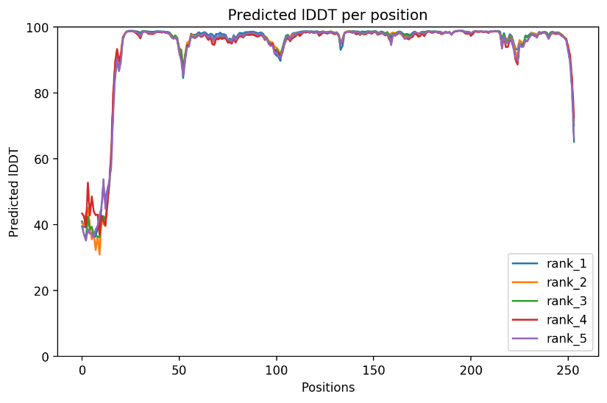
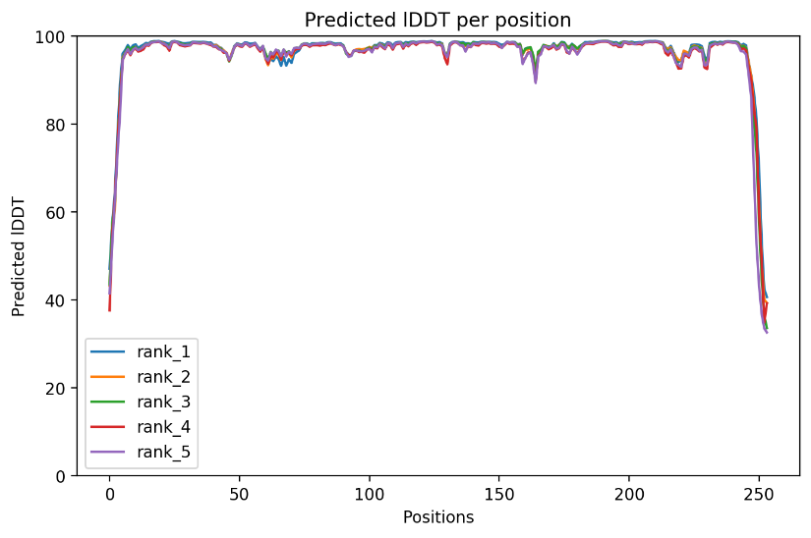
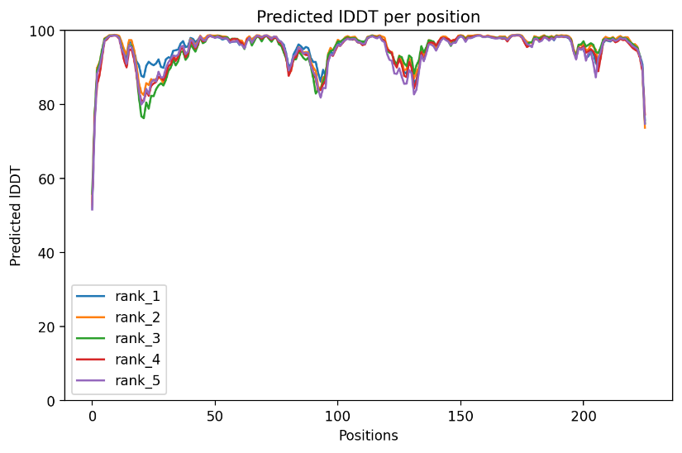
Predicted lDDT per position 1AQ6
Predicted lDDT per position 1JUD
Predicted lDDT per position 2W43
Predicted lDDT per position 3UM9
Predicted lDDT per position 3UMB
Predicted lDDT per position 3UMC
Predicted lDDT per position 3UMG
Predicted lDDT per position Adeh3811

Slide 2
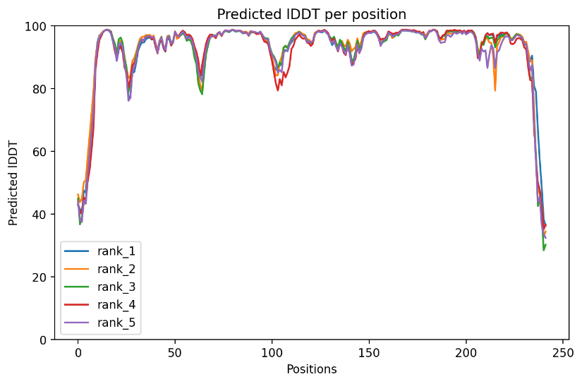
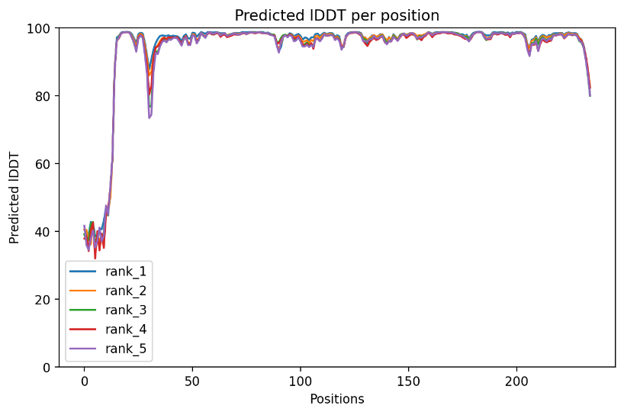
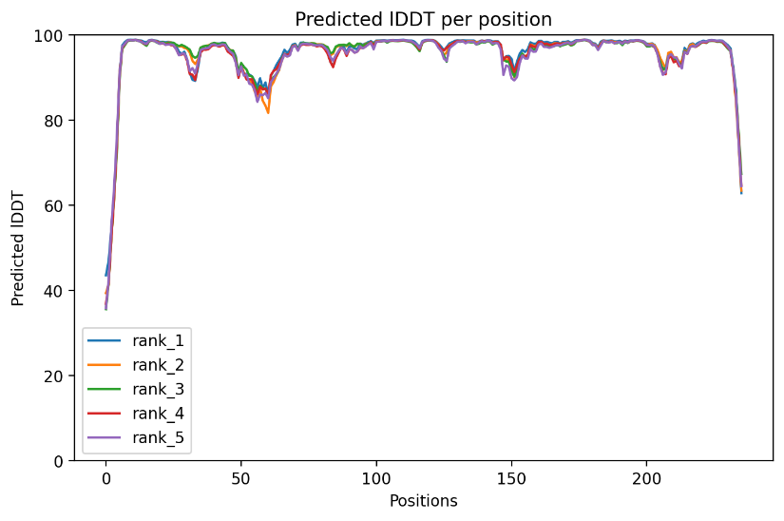
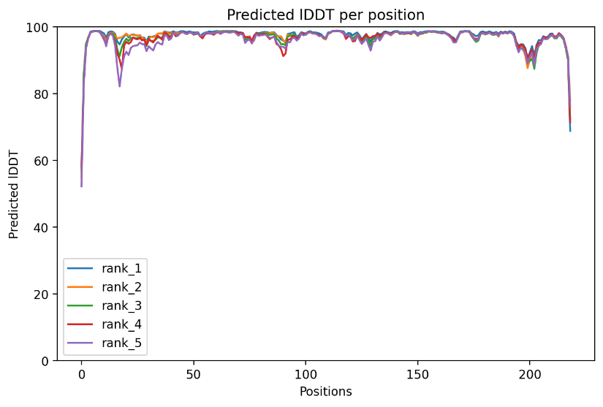
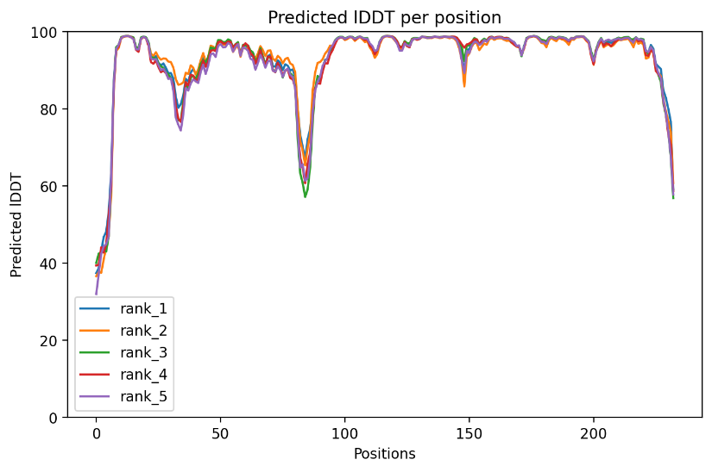
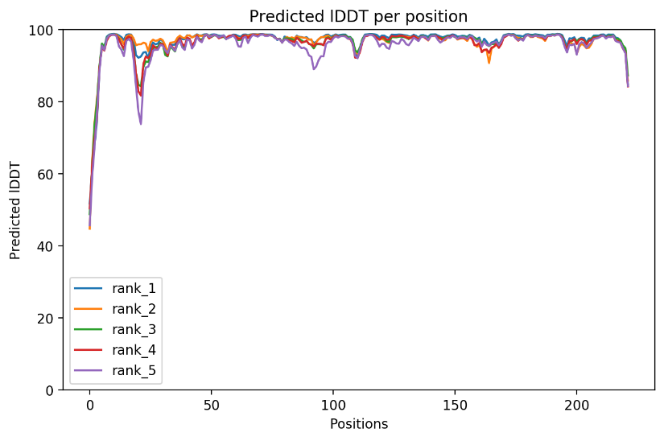
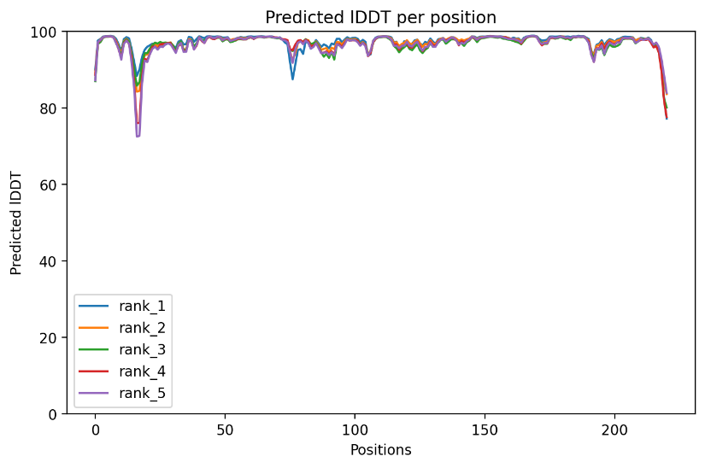
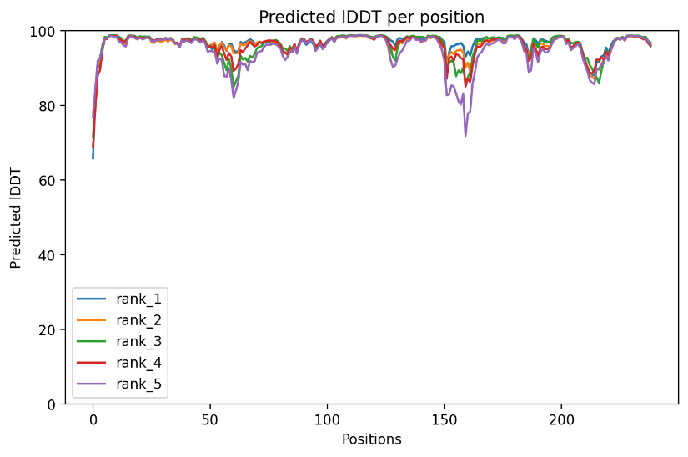
Predicted lDDT per position Bpro4516
Predicted lDDT per position GKG916071
Predicted lDDT per position WP0046934401
Predicted lDDT per position WP050688410
Predicted lDDT per position WP0066862581
Predicted lDDT per position WP0534284051
Predicted lDDT per position WP0871899911
Predicted lDDT per position WP1187090781

Slide 3
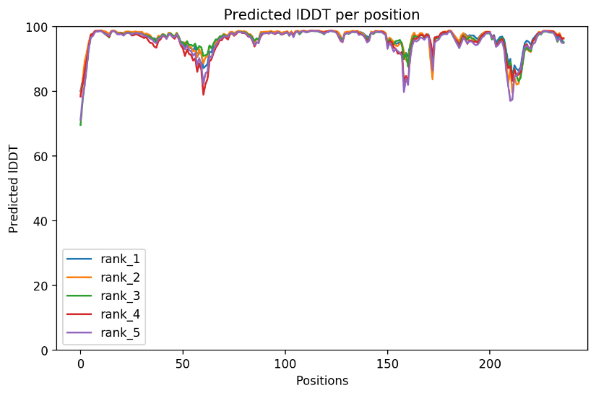
Predicted lDDT per position WP1786180371

